Slide 1
Integrating a PDE Model of Chemotaxis using FEniCS
Palmer Edholm, Menna Gouda & Jake McClure
Math 6810 Project
Under Supervision of Dr. Jia Zhao

Slide 2
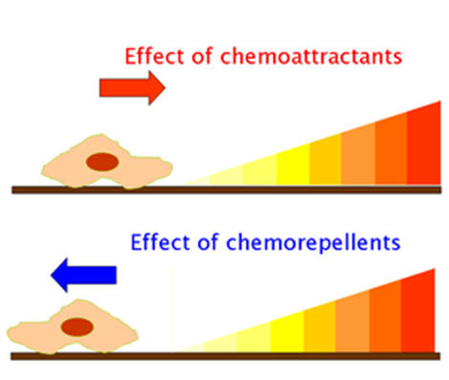
Introduction to Chemotaxis
It could be thought of as “biased random motion”
It is the directed motion of a cell towards the concentration gradient of a chemoattractant or down a concentration gradient of a chemorepellent.
The interplay of diffusion and production rates of chemical forms creates a gradient.
A gradient “∇” : is the rate of ascent or descent.

Slide 3
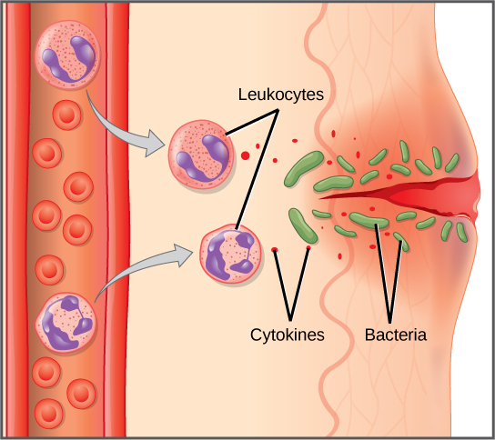
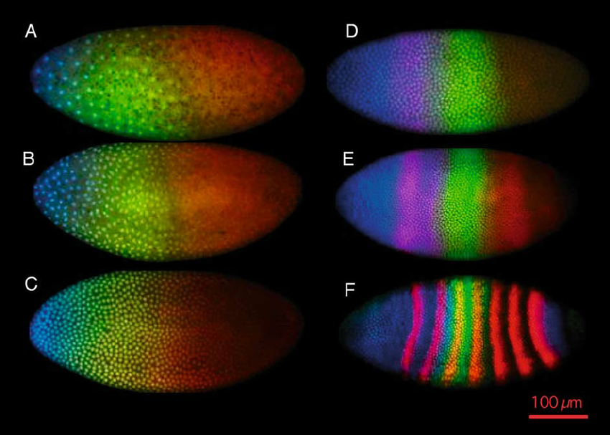
Biological events depending on chemotaxis
Attracting organisms to food
Embryonic cells into developing tissues
Immune cells to infection sites
Animals towards potential mates

Slide 4
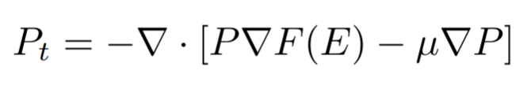
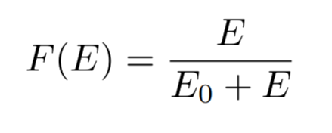
Chemotaxis PDE Model
Variables
Fruit flies (P)
Ethanol (E)
Fruit flies want to follow ethanol!
F(E) is a fly’s perception of ethanol
Flies move in direction of increasing F(E)
where

Slide 5
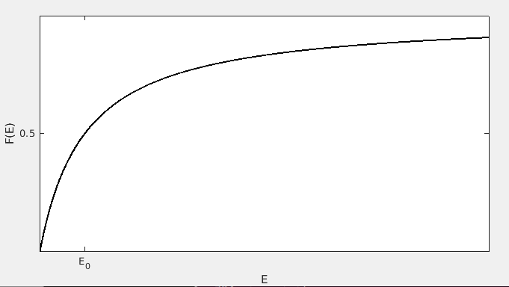
Functional Response to Ethanol
Holling type II response
E_0 is the half-saturation level of ethanol, where F(E_0) = 0.5.

Slide 6
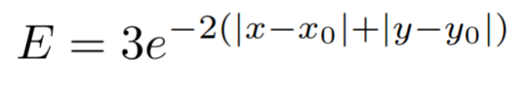
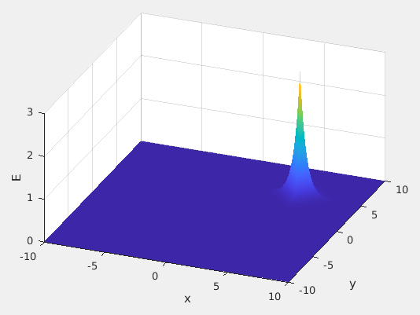
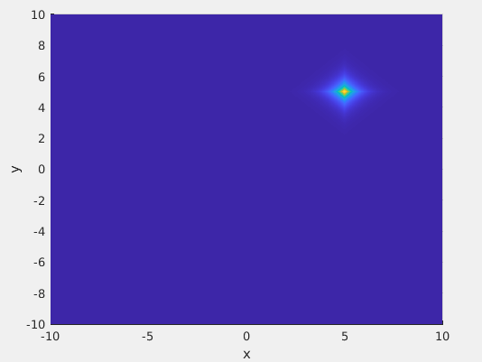
Ethanol Distribution

Slide 7
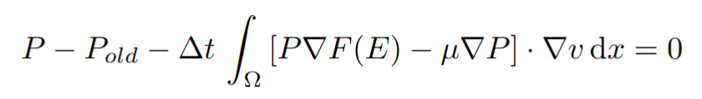
Variational Form of the Model
Nonlinear!
Uses a grad of… a function of… a variable?

Slide 8

Methods
What else… FEniCS!
Nonlinear - can’t use TrialFunction( )
Use nonlinear Newton solver
A function of E - cast the Function( ) E as a variable

Slide 9
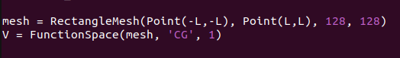
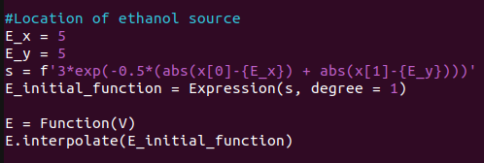
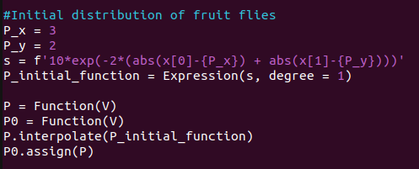
The Code

Slide 10
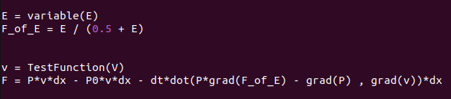
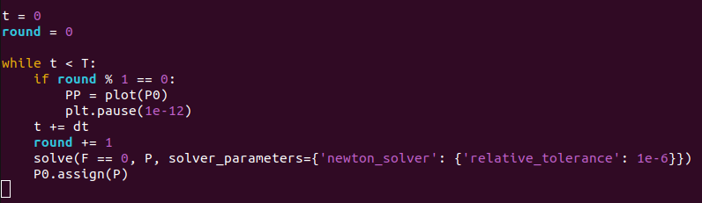
The Code

Slide 11
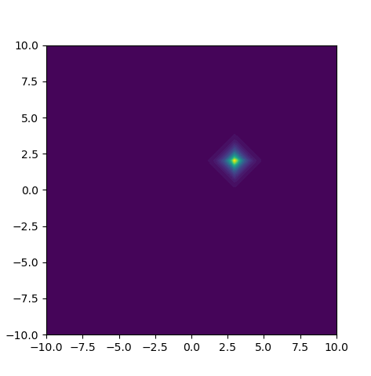
Results - One Source
Ethanol source @ (5, 5).
The initial distribution of fruit flies is centered around (2, 3).

Slide 12
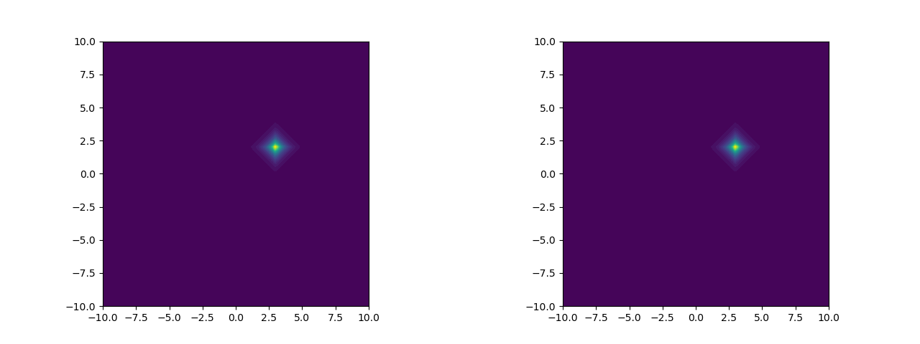
Results - Two Sources
Source @ (5, 5)
Sources @ (5, 5) and (0, 0)
Both sources are equidistant from the fruit flies… why do they prefer the (5, 5) source?

Slide 13
Results - Different Saturation Parameter
E_0 = 0.5
E_0 = 0.1
When E_0 is lower, flies are less discerning of the presence of ethanol.

Slide 14
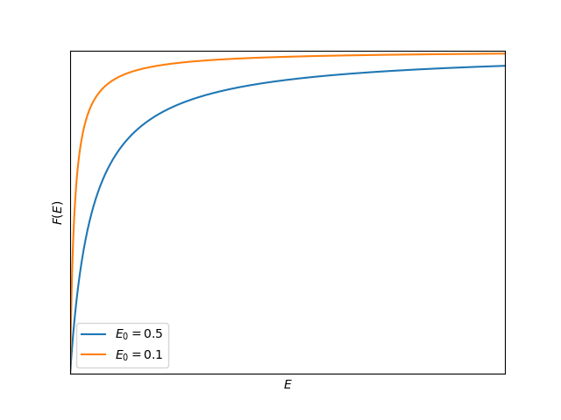
Results - Different Saturation Parameter, cont.
Lower saturation parameter leads to flatter slope.
Fruit flies have a harder time sensing the change in Ethanol.

Slide 15
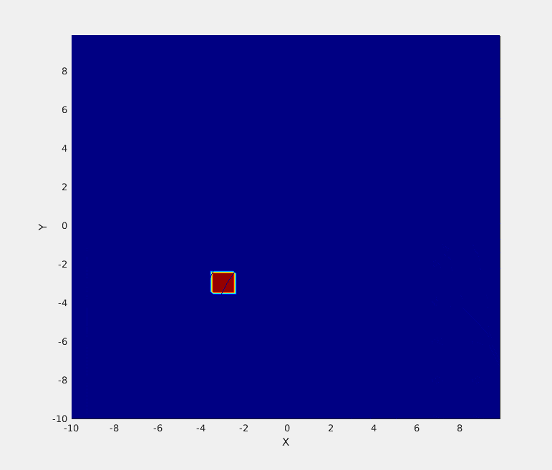
Comparison: IDE Model
Integro-Difference Equations
Discrete-time, continuous-space models
Often approximations to PDE solutions, found with asymptotics
Adapted from Powell, J. (2022).

Slide 16
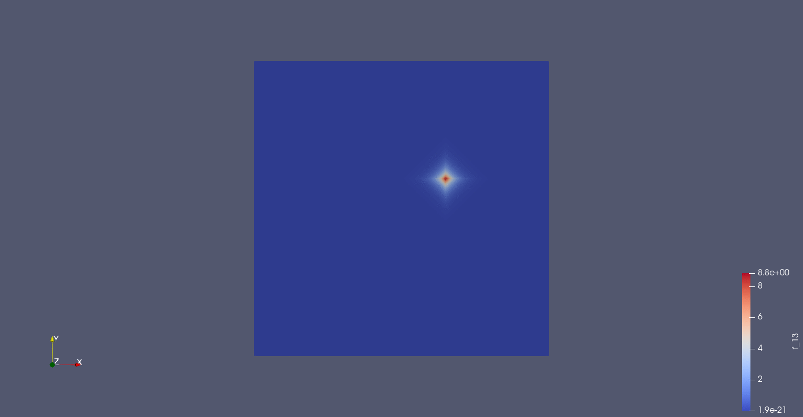
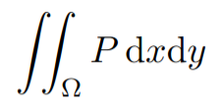
Weaknesses
Is not conserved!

Slide 17
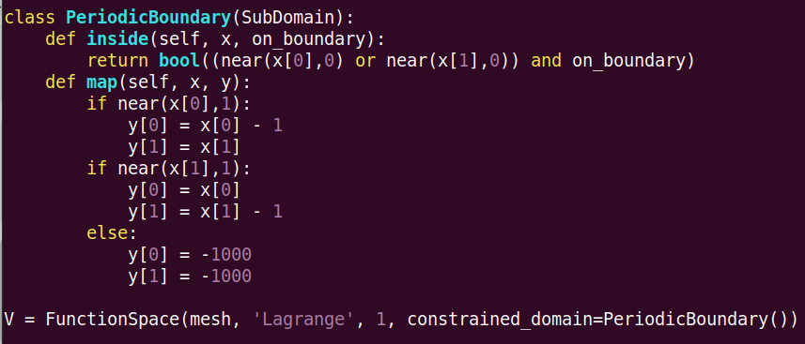
Periodic Boundary?

Slide 18
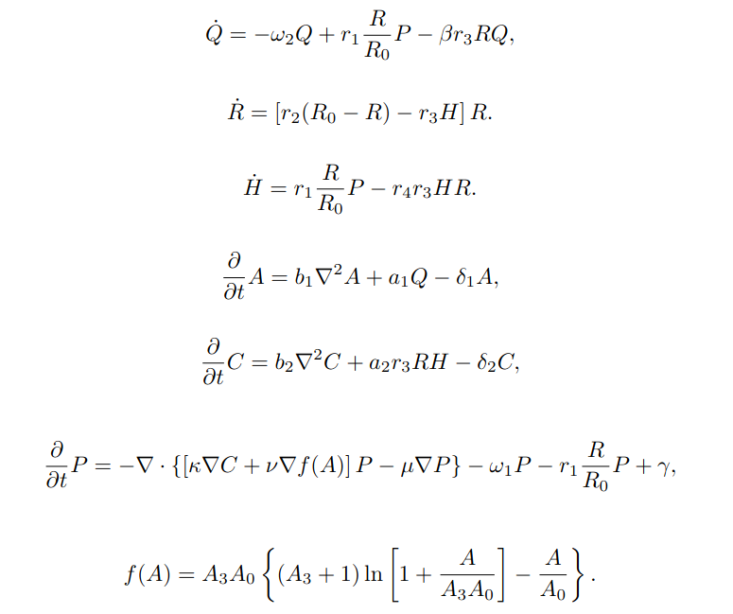
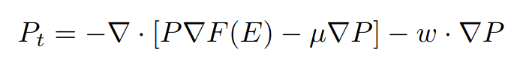
Future directions
Mountain Pine Beetle model?
Add advection term?
Adapted from Powell, J. (1998).

Slide 19
References
Powell, J. (2022). Spatiotemporal Models in Ecology: An Introduction to Integrodifference Equations Computational Labs.
Powell, J. A., Mcmillen, T., White, P., & Appl Math, S. J. (1998). CONNECTING A CHEMOTACTIC MODEL FOR MASS ATTACK TO A RAPID INTEGRO-DIFFERENCE EMULATION STRATEGY *. http://www.siam.org/journals/siap/59-2/31345.html

Slide 20
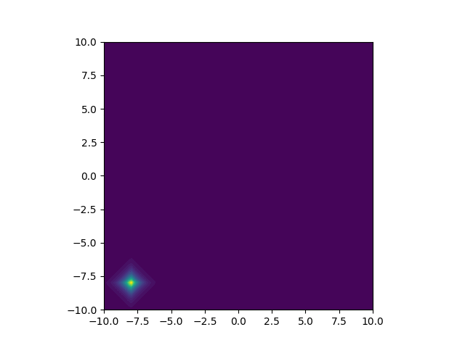
Thank you!

